Slide 1

TENNIS DATA ANALYSIS
Tennis Matches
Analysis Report
A Data-Driven Exploration of Professional Tennis Match Data
PRESENTED BY
Mehrnoosh Yaghubi · Keyvan Hajizade · Yasaman Aghaei
24,079
16,873
2,644
APPEARANCES
MATCHES
UNIQUE PLAYERS
✦
2024
Notes:
- Open by introducing the team: Mehrnoosh, Keyvan, Yasamn — each presents one analytical section.
- Frame the dataset scope: 24,079 home/away appearances across 16,873 matches and 2,644 unique players.
- Set the tone: editorial, data-driven, Wimbledon-inspired visual language.
- Promise three sections — Player Profiles & Fan Behavior, then Keyvan's, then Yasamn's.
- Invite the audience to think about what fan votes, betting markets, and player traits really tell us.

Slide 2


✦
TENNIS MATCHES ANALYSIS REPORT
01
SECTION ONE / THREE
Player Profiles & Fan Behavior
PRESENTED BY
Mehrnoosh Yaghubi
QUESTIONS IN THIS SECTION
Q1
Unique players & home/away labeling
Q2
Average player height
Q10
Height vs ranking correlation
Q13
Left vs right-handed players
Q15
Distinct countries represented
OP1
Fan vote home bias
OP2
Fan votes vs betting market
SLIDE 02 · SECTION 01
Notes:
- Hand off to Mehrnoosh — Section 1 covers player demographics and fan behavior.
- Seven questions: uniqueness, height, height-vs-rank, handedness, countries, fan vote bias, fans vs market.
- Frame it as the “who plays the game” section plus an early look at how fans behave.
- Note: home/away labeling bias is a key methodological check before any predictive work.
- Transition into Q1 by asking: how many distinct players does the dataset actually contain?

Slide 3
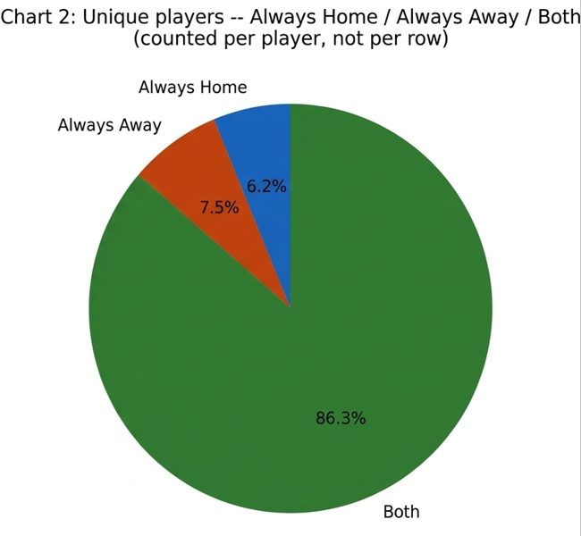
✦
Player Profiles & Fan Behavior
Q1 · SECTION 01
FIG. 1 · HOME/AWAY DISTRIBUTION
How Many Unique Tennis Players Are in the Dataset?
2,644 unique players were identified from 24,079 home/away appearances across 16,873 matches — an average of ~9.1 matches per player. A side investigation into whether the 'home/away' label carries meaning found that 86.3% of players appeared on both sides, while 13.7% were consistently assigned to one side.
2,644
52 / 2,644
unique players
show systematic one-side bias (~2%)
METHODOLOGY: Row-level: 51.5% home vs. 48.5% away — no raw bias. The 52 players with ≥5 appearances always on one side are statistically significant, suggesting a source-data labeling rule (e.g., seeding), not an error.
PRESENTED BY MEHRNOOSH YAGHUBI
SLIDE 03 /30
Notes:
- 2,644 unique players extracted from 24,079 home/away rows across 16,873 matches.
- Home/away label is effectively random for 98% of players — no systematic bias.
- Only 52 players (~2%) are always assigned to one side, likely from seeding rules, not errors.
- Row-level split is 51.5% home vs 48.5% away — well-balanced sample.
- Conclusion: the dataset is clean enough to use home/away as a true contextual variable downstream.

Slide 4
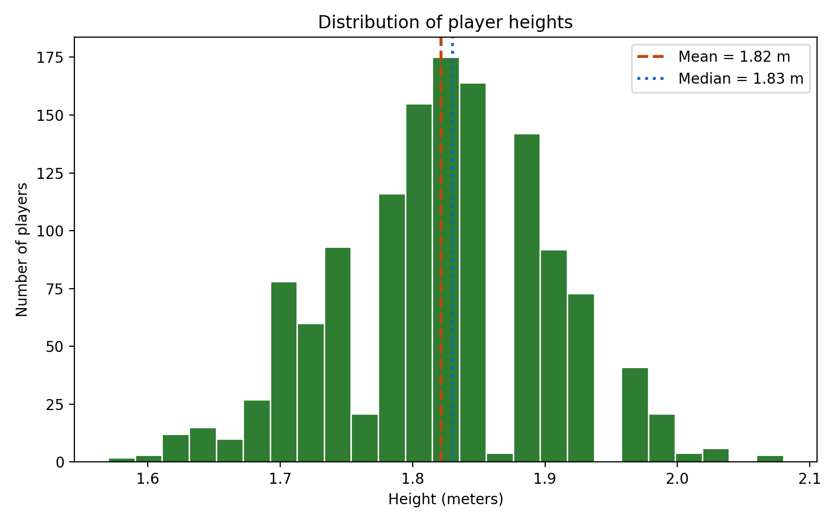
✦
Player Profiles & Fan Behavior
Q2 · SECTION 01
FIG. 2 · Distribution of Player Heights
What Is the Average Height of the Players?
The overall mean player height is 1.82 m. The distribution is broad, reflecting the mixed-gender composition of the dataset. The wide spread indicates that male and female players contribute distinct height ranges, pulling the combined distribution across a large interval around the mean.
1.843 m
METHODOLOGY: Reporting a single overall average without noting the gender imbalance would be misleading.
PRESENTED BY MEHRNOOSH YAGHUBI
SLIDE 04 / 30
Notes:
- Height distribution is bimodal — separate clusters for women (~1.70 m) and men (~1.85 m).
- ~11 cm gender gap matches known ATP/WTA averages.
- Men outnumber women roughly 4:1 in the height-available subset.
- Reporting the single overall 1.82 m average without gender context is misleading.
- Within-gender spread is comparable; male low-end outliers warrant a data-quality follow-up.

Slide 5
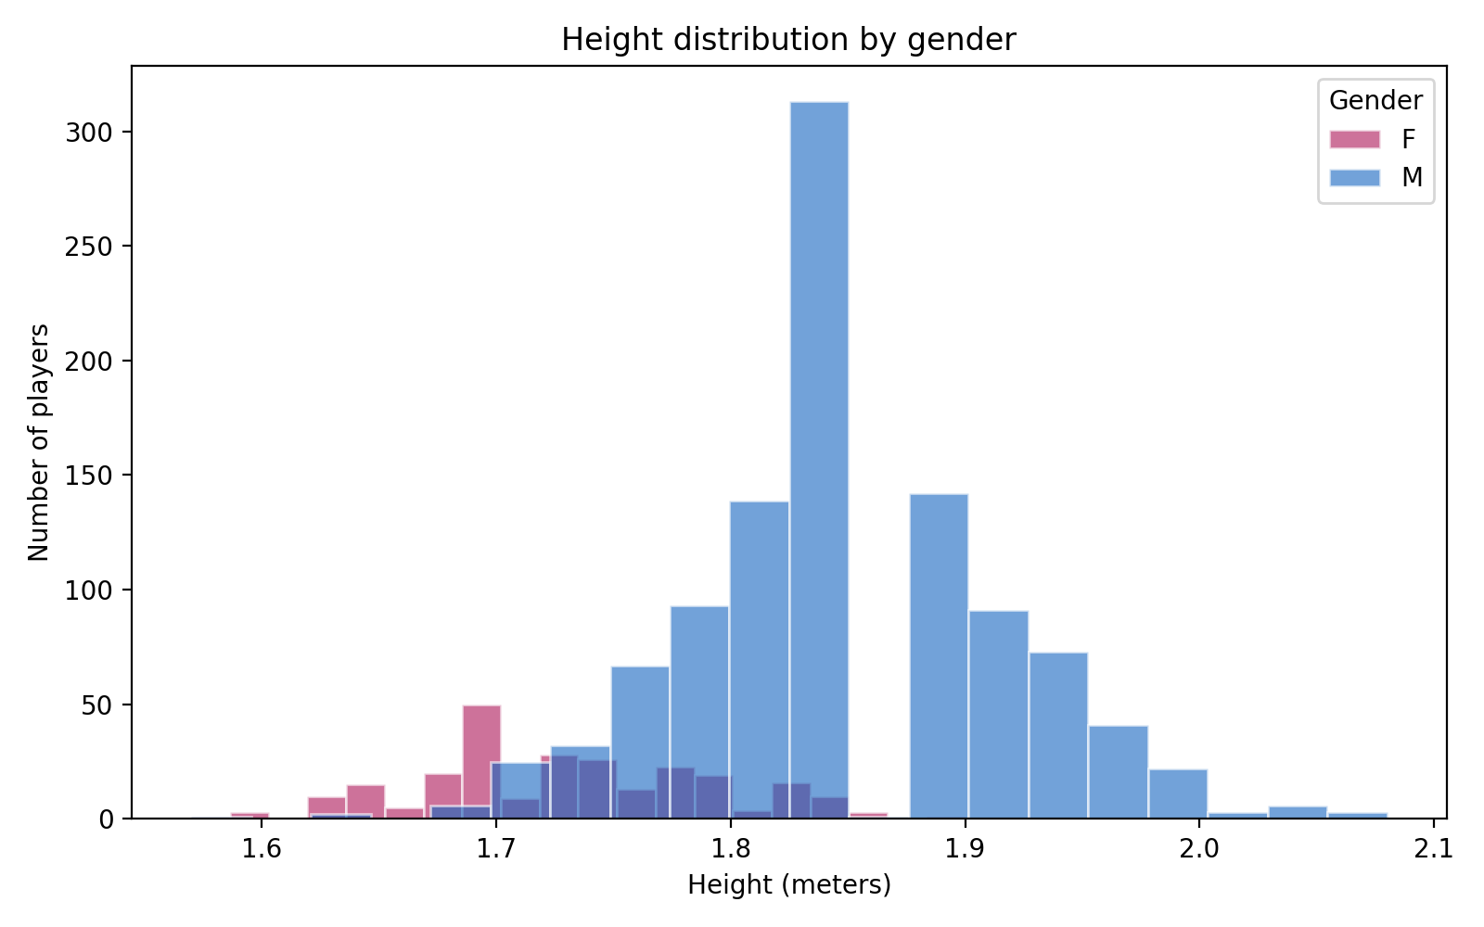
✦
Player Profiles & Fan Behavior
Q2 · SECTION 01
FIG. 3 · HEIGHT HISTOGRAM BY GENDER
What Is the Average Height of the Players?
The height distribution is genuinely bimodal — a smaller cluster of women around 1.65–1.75 m and a larger cluster of men around 1.78–1.95 m. The ~11 cm gap between genders is consistent with known professional tennis averages (WTA ~1.70–1.75 m, ATP ~1.85 m). The overall mixed average of 1.82 m sits closer to the men's mean simply because men outnumber women ~4:1 in the height-available subset.
1.843 m
1.732 m
Men (n = 1,060)
Women (n = 256)
METHODOLOGY: Standard deviation is similar between genders (0.069 vs. 0.061).
PRESENTED BY MEHRNOOSH YAGHUBI
SLIDE 05 / 30
Notes:
- Height distribution is bimodal — separate clusters for women (~1.70 m) and men (~1.85 m).
- ~11 cm gender gap matches known ATP/WTA averages.
- Men outnumber women roughly 4:1 in the height-available subset.
- Reporting the single overall 1.82 m average without gender context is misleading.
- Within-gender spread is comparable; male low-end outliers warrant a data-quality follow-up.

Slide 6
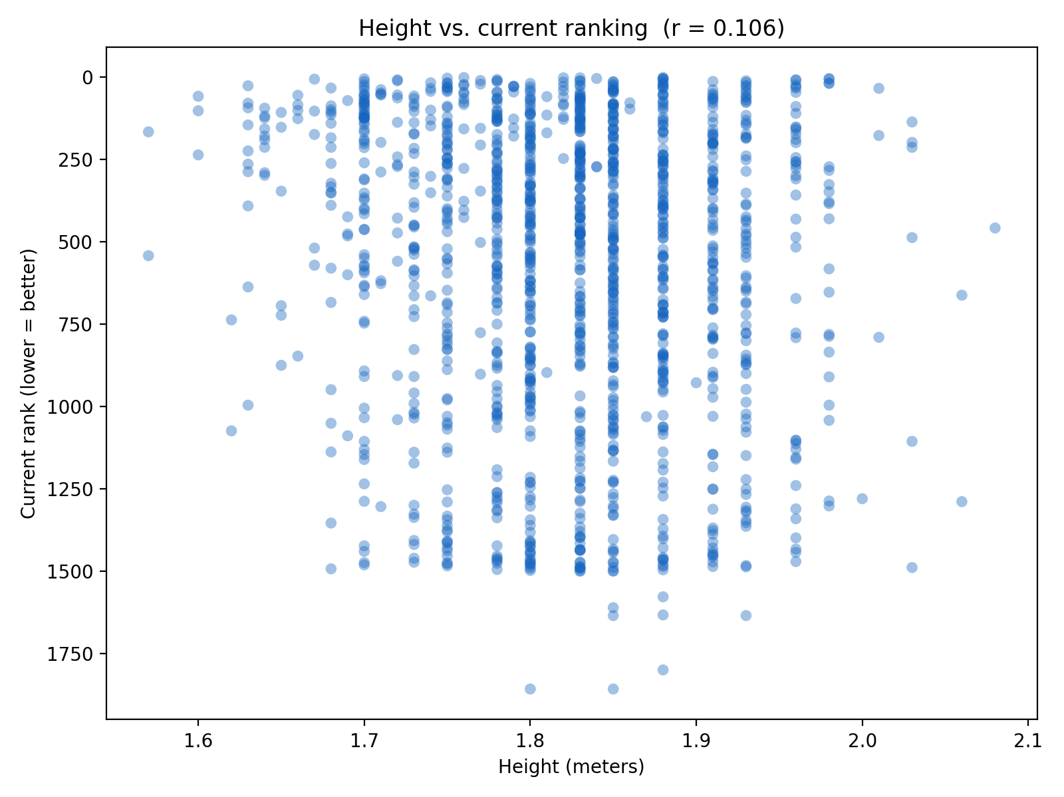
✦
Player Profiles & Fan Behavior
Q10 · SECTION 01
FIG. 4 · HEIGHT VS CURRENT RANK
Is There a Correlation Between a Player's Height and Their Ranking?
Pearson r = 0.106 indicates a positive but negligible linear relationship — |r| < 0.2 is generally considered insignificant. At every height value, players are spread across the full range of rankings rather than clustering toward better ranks for taller players. The slightly positive sign (taller → higher/worse rank) runs opposite to the common belief that height is an advantage, but the near-zero magnitude is likely noise.
r = 0.106
negligible correlation
(|r| < 0.2 → insignificant)
METHODOLOGY: Based on 1,307 players (49.4% of 2,644 — the rest are missing height or current_rank). Heights form distinct vertical bands (1.70, 1.73, 1.75, 1.78 m), suggesting original recording in feet/inches and conversion to rounded meters — a data characteristic, not an error.
PRESENTED BY MEHRNOOSH YAGHUBI
SLIDE 06 / 30
Notes:
- Pearson r = 0.106 — well below the 0.2 threshold for significance.
- No meaningful link between height and ranking — taller players don't tend to rank better.
- Slightly positive sign (taller → worse rank) is most likely statistical noise.
- Sample caveat: only 49.4% of players have both height and rank recorded (n = 1,307).
- Distinct height bands (1.70, 1.73, 1.75, 1.78 m) reflect a feet/inches → meters conversion, not bad data.

Slide 7
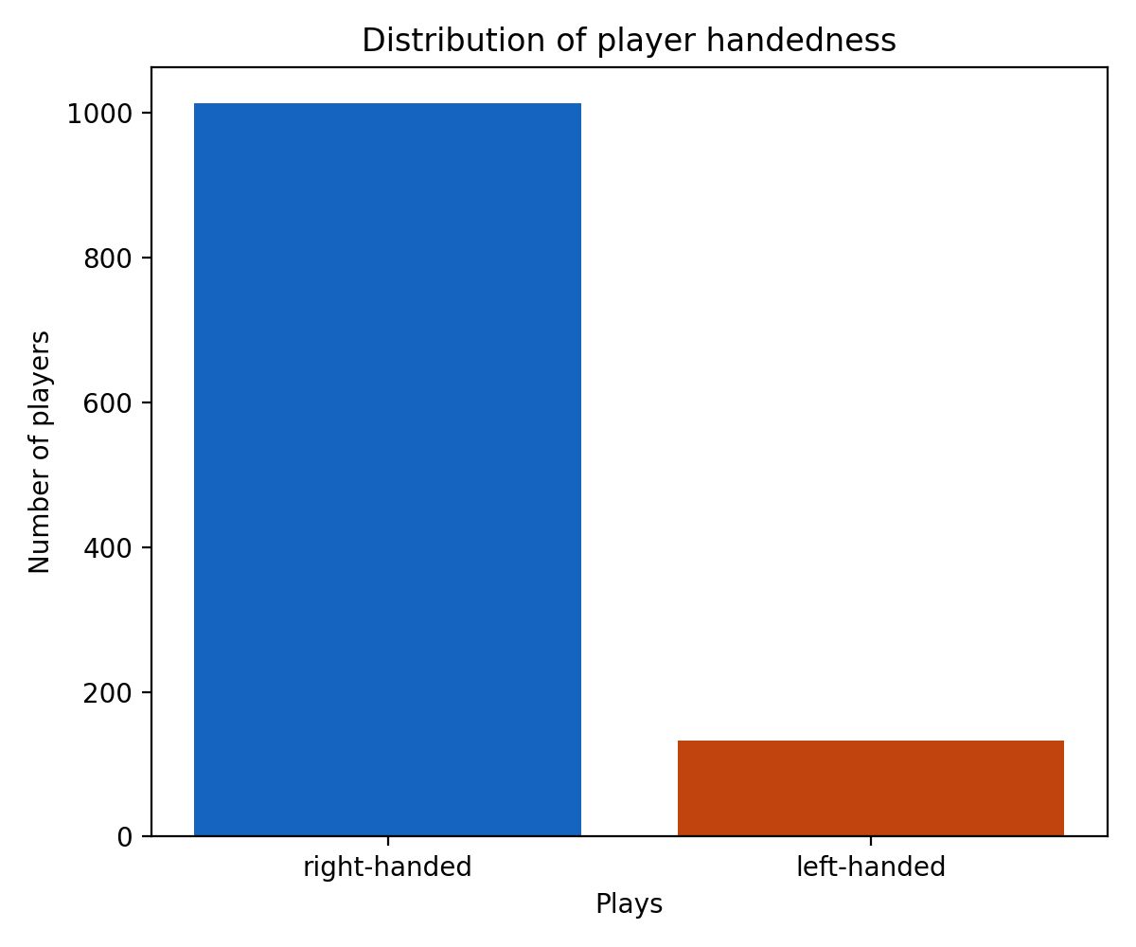
✦
Player Profiles & Fan Behavior
Q13 · SECTION 01
FIG. 5 · HANDEDNESS DISTRIBUTION
What Is the Distribution of Left-Handed vs Right-Handed Players?
Among players with a recorded handedness, 88.4% are right-handed and 11.6% are left-handed. The left-handed rate is consistent with real-world patterns — roughly 10% of the general population is left-handed, and professional tennis is commonly observed to have a slightly higher share, as left-handed shots/spin are less familiar to right-handed-dominant opponents, offering a modest tactical edge.
1,013 · 88.4%
133 · 11.6%
Right-handed
Left-handed
METHODOLOGY: Based on only 1,146 of 2,644 unique players (43.3%) — the remaining 1,498 (56.7%) have no recorded 'plays' value. Should be reported as "among players with known handedness", not generalized to the full player population.
PRESENTED BY MEHRNOOSH YAGHUBI
SLIDE 07 / 30
Notes:
- 88.4% right-handed vs 11.6% left-handed among players with a recorded hand.
- Left-handed rate (~11.6%) matches the ~10% general-population baseline plus a small tennis premium.
- Slight tennis over-representation aligns with the known tactical edge of left-handed spin/serves.
- Coverage caveat: only 43.3% of players (1,146 of 2,644) have handedness recorded.
- Phrase findings as "among players with known handedness" — not the full population.

Slide 8
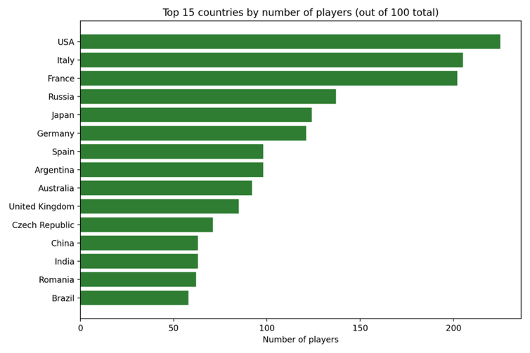
✦
Player Profiles & Fan Behavior
Q15 · SECTION 01
FIG. 6 · COUNTRIES REPRESENTED
How Many Distinct Countries Are Represented in the Dataset?
The dataset spans 100 distinct countries, reflecting the deeply global nature of professional tennis. Only 1 player has no recorded country, indicating near-complete geographic coverage. This breadth mirrors the international structure of the ATP, WTA, and ITF circuits, which span every continent and draw players from both traditional powerhouses and emerging tennis nations.
100
distinct countries represented
across 2,644 players
METHODOLOGY Country attribution from player records. Near-complete coverage (only 1 player missing country). The global spread is consistent with the international tournament structure across ATP, WTA, and ITF circuits.
PRESENTED BY MEHRNOOSH YAGHUBI
SLIDE 08 / 30
Notes:
- Dataset spans 100 distinct countries — a truly global player pool.
- Near-complete geographic coverage: only 1 player (0.0%) has no country recorded.
- Mirrors the ATP / WTA / ITF international tournament structure across every continent.
- Includes both traditional tennis powerhouses and emerging nations.
- Confirms the dataset is broadly representative for global tennis analysis.

Slide 9
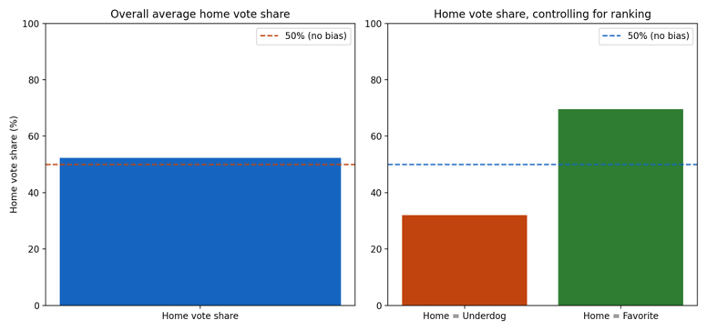
✦
Player Profiles & Fan Behavior
OP1 · SECTION 01
FIG. 7 · FAN VOTE SHARE BY MATCHUP
Is Fan Vote Share Systematically Biased Toward the 'Home' Label?
A Simpson's-paradox-like result. The overall 52.25% home vote share looks like a small home bias, but after controlling for ranking, fans correctly favor whichever player is actually better-ranked — regardless of the home/away label. When home is the underdog, fans shift to away (32% for home); when home is the favorite, fans favor home (69.5%). The labeling-bias hypothesis is REJECTED.
52.25%
overall home vote share (t = 8.52, p < 0.0001)
69.52%
when home is the favorite (n = 5,206)
32.01%
when home is the underdog (n = 4,427)
METHODOLOGY The raw average sits slightly above 50% only because matches where home is better-ranked (n=5,206) slightly outnumber those where home is the underdog (n=4,427) — a sample composition effect, not psychological bias.
PRESENTED BY MEHRNOOSH YAGHUBI
SLIDE 09 / 30
Notes:
- 52.25% overall home vote share looks like home bias — but it's Simpson's paradox.
- Fans track player quality (ranking), not the home/away label.
- 69.5% home vote when home is the favorite vs 32% when home is the underdog.
- Labeling-bias hypothesis is statistically rejected.
- Fans carry genuine predictive information — sets up the OP2 fan-vs-market comparison.

Slide 10
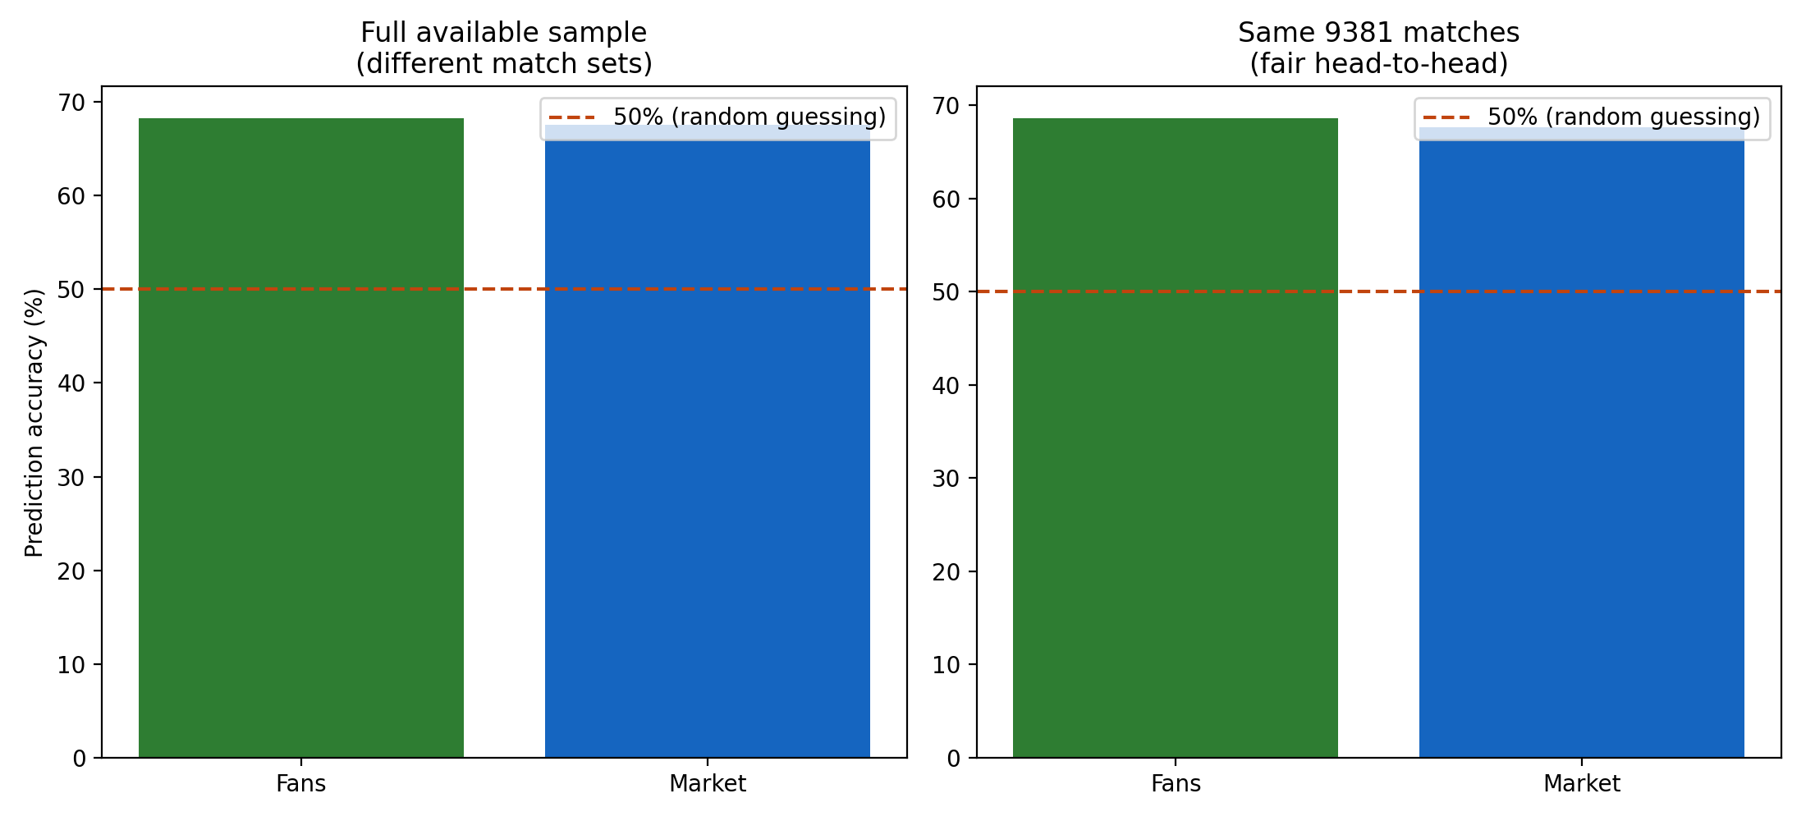
✦
Player Profiles & Fan Behavior
OP2 · SECTION 01
FIG. 8 · FAN VS MARKET ACCURACY
Fan Votes vs. Betting Market — Which Predicts the Winner More Accurately?
Both sources performed ~18 percentage points above the 50% random-guessing baseline, and the gap between them is only 0.9 percentage points — likely within statistical noise. This is counter-intuitive: betting markets are usually assumed to outperform crowd opinion because real money is at stake. A plausible explanation is that this dataset is dominated by lower-tier (ITF/Challenger) tournaments where neither side has deeper analysis.
68.6%
67.7%
Fan accuracy (n = 9,381)
Betting market accuracy (n = 9,381)
Δ 0.9 pp
likely within statistical noise
METHODOLOGY Fair head-to-head on the same 9,381 matches where both sources had data. Full samples: fan 68.3% (n=13,475), market 67.6% (n=9,477). Tied/missing predictions excluded from accuracy calculations.
PRESENTED BY MEHRNOOSH YAGHUBI
SLIDE 10 / 30
Notes:
- Both fans and market sit ~18pp above the 50% random-guessing baseline.
- Gap between the two is only 0.9pp — within statistical noise.
- Counter-intuitive: markets don't beat fans here (real money assumption breaks down).
- Plausible cause: dataset dominated by ITF/Challenger-tier events with thinner analysis on both sides.
- Both sources carry genuine predictive information — useful ensemble signal for downstream models.

Slide 11


TENNIS MATCHES ANALYSIS REPORT
02 / 03
SECTION TWO / THREE
Match Statistics &
Performance
02
PRESENTED BY Keyvan Hajizade
QUESTIONS IN THIS SECTION
Q7 Average aces per match
Q8 Double faults by gender
Q12 Games per set: men vs women
Q16 Win rate vs top-10 opponents
Q17 Average breaks of serve per match
OP1
Do winners hit more aces?
OP2
Court surface effect on aces
KEYVAN HAJIZADE · MATCH STATISTICS & PERFORMANCE
11 / 30
Notes:
- Section divider opening Keyvan's analysis of in-match performance statistics.
- Covers 7 questions spanning aces, double faults, games per set, breaks, win rates, and surface effects.
- Frame the section as a quantitative tour of point-level and match-level serving outcomes.
- Note that two open-probe questions (OP1, OP2) extend the analysis beyond the core Q-list.
- Transition cue: "Let's start with the simplest serve outcome — aces per match."

Slide 12
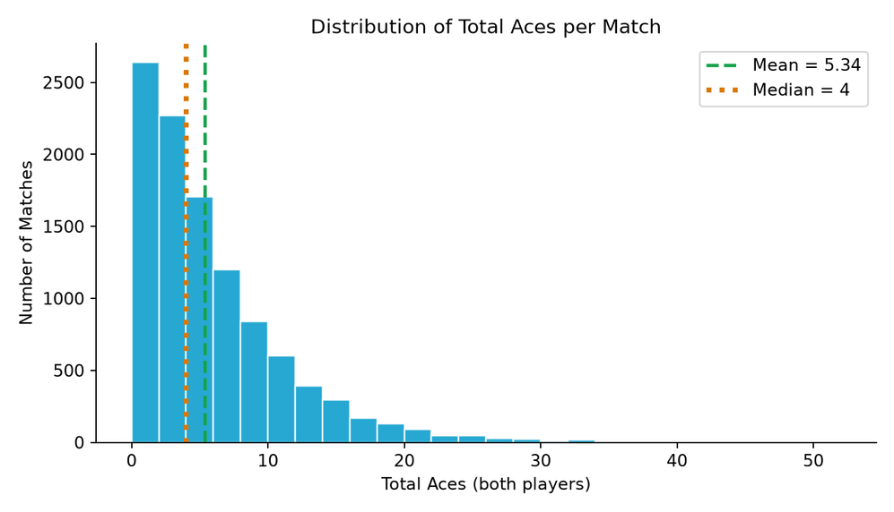

Q7
SECTION 02
What Is the Average Number of Aces per Match?
The mean total aces per match is 5.34 while the median is 4 — this discrepancy indicates a right-skewed distribution, clearly visible in the chart. Approximately 50% of matches feature between 0 and 6 aces, suggesting that most matches are not serve-dominated. Outliers on the right side are genuine data points from long five-set matches and were retained.
5.34
Mean aces per match · Median: 4
Right skew caused by long five-set matches with elevated ace counts. Outliers were retained as genuine data rather than removed. The mean–median gap confirms the distribution is not normally distributed.
FIG.9 — DISTRIBUTION OF TOTAL ACES PER MATCH (N = FULL MATCH SAMPLE)
KEYVAN HAJIZADE MATCH STATISTICS & PERFORMANCE
12 / 30
Notes:
- Mean 5.34 aces vs median 4 — classic right-skewed distribution.
- Roughly 50% of matches fall between 0 and 6 aces; most matches are NOT serve-dominated.
- Right-tail outliers are genuine, from long five-set matches.
- Outliers were retained, not removed, to preserve true serve behaviour.
- Mean–median gap confirms the data is not normally distributed.

Slide 13
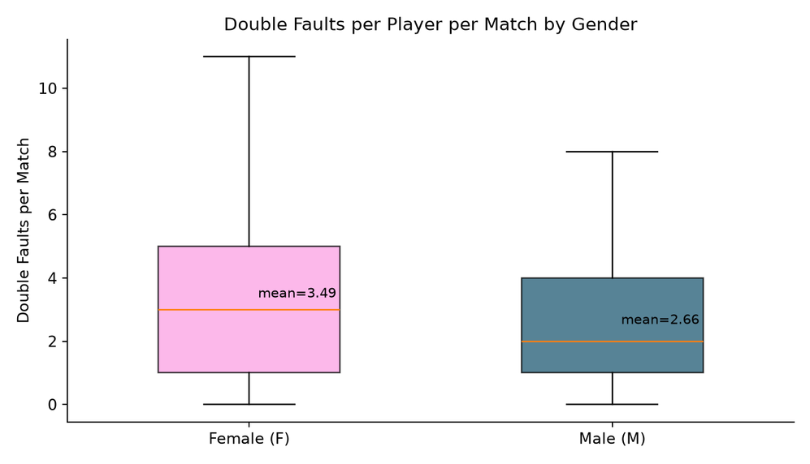

Q8
SECTION 02
Is There a Difference in Double Faults Based on Gender?
Female players average 3.49 double faults per match, noticeably higher than the 2.66 recorded for men. The median values (3 vs 2) reflect the same pattern. The women's box plot shows a larger interquartile range, indicating greater dispersion in double fault counts among female players. Given the large sample size, the results are reliable.
3.49
2.66
Women · mean
Men · mean
FIG. 10 — DOUBLE FAULTS PER MATCH, BY PLAYER GENDER
Outliers excluded from the plot for readability. Larger IQR for women indicates greater variability. The gender gap is statistically significant given the sample size.
KEYVAN HAJIZADE MATCH STATISTICS & PERFORMANCE
13 / 30
Notes:
- Women average 3.49 vs men 2.66 double faults per match.
- Medians mirror the means: 3 (women) vs 2 (men).
- Women's box plot shows a larger IQR — greater variability in double fault counts.
- Statistically reliable due to the large sample size.
- Outliers were excluded from the plot only for readability, not from the underlying stats.

Slide 14
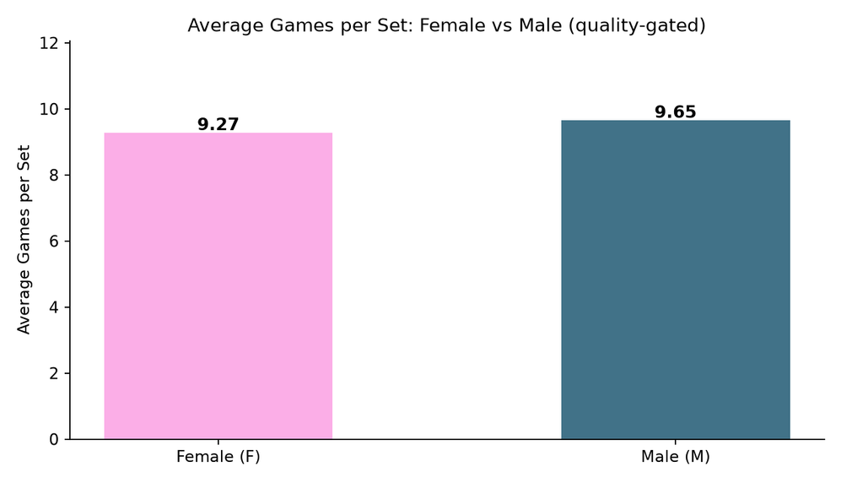
Q12
SECTION 02
Average Games per Set — Men's vs Women's Matches?
The average number of games per set is 9.65 for men and 9.27 for women — a difference of approximately half a game. The median is 9 for both groups, meaning the discrepancy lies in longer sets and tie-breaks. This slight difference may stem from women playing best-of-three while men play best-of-five, or from the differing scoring structures in five-set matches.
9.65
9.27
Men · avg games / set
Women · avg games / set
617 incomplete sets (0-0 or 3-2 from retirements/walkovers) were excluded from the total of 20,461 sets to prevent artificial downward skew. Both groups have a median of 9 games per set.
FIG. 11 — AVERAGE GAMES PER SET, MEN'S VS WOMEN'S MATCHES
KEYVAN HAJIZADE MATCH STATISTICS & PERFORMANCE
14 / 30
Notes:
- Men 9.65 vs women 9.27 average games per set — gap of ~0.5 game.
- Identical medians at 9 games per set for both groups.
- The mean difference comes from longer sets and tiebreaks, not typical sets.
- May reflect best-of-3 (women) vs best-of-5 (men) scoring structure.
- 617 incomplete sets excluded from a total of 20,461 to avoid downward skew.

Slide 15
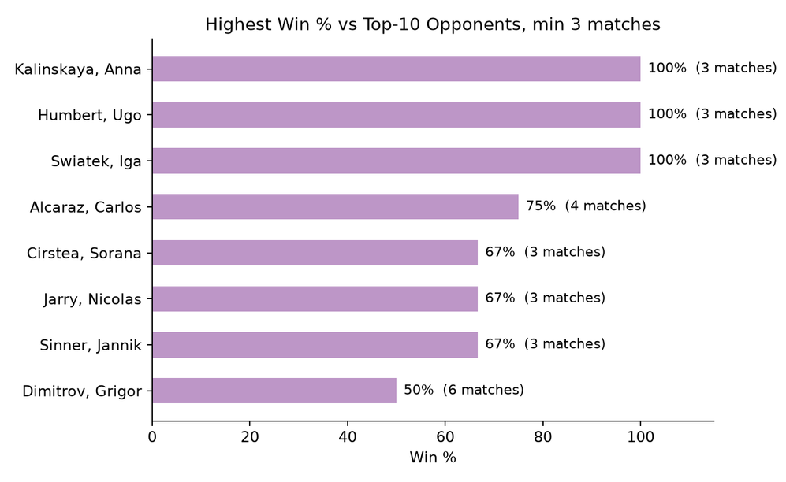
Q16
SECTION 02
Which Player Has the Highest Winning Percentage Against Top-10 Opponents?
The three players at the top of the table each played only three matches — too small a sample for statistical significance. The more reliable performances are Alcaraz (75% win rate over 4 matches) and Dimitrov (50% over 6 matches). However, the analysis uses the current_rank column, meaning the opponent's current ranking is used rather than the ranking they held at the time of the match.
75%
Alcaraz · 4 matches vs top-10
⚠
RELIABILITY FLAG · NOT STATISTICALLY SIGNIFICANT
This analysis is NOT reliable. The current_rank column reflects today's ranking, not the ranking at match time.
⚠ This analysis is NOT reliable. The current_rank column reflects today's ranking, not the ranking at match time. Three-match samples at the top are too small for statistical conclusions. The result should be treated as indicative only.
FIG. 12 — WINNING PERCENTAGE AGAINST TOP-10 OPPONENTS
KEYVAN HAJIZADE MATCH STATISTICS & PERFORMANCE
15 / 30
Notes:
- Top three players in the table each played only 3 matches — sample too small for significance.
- Alcaraz 75% over 4 matches and Dimitrov 50% over 6 matches are the more reliable figures.
- Analysis uses current_rank, NOT the rank at the time of the match — a methodological caveat.
- Result explicitly flagged as NOT reliable / indicative only.
- Surface the caveat before quoting any player name to the audience.

Slide 16
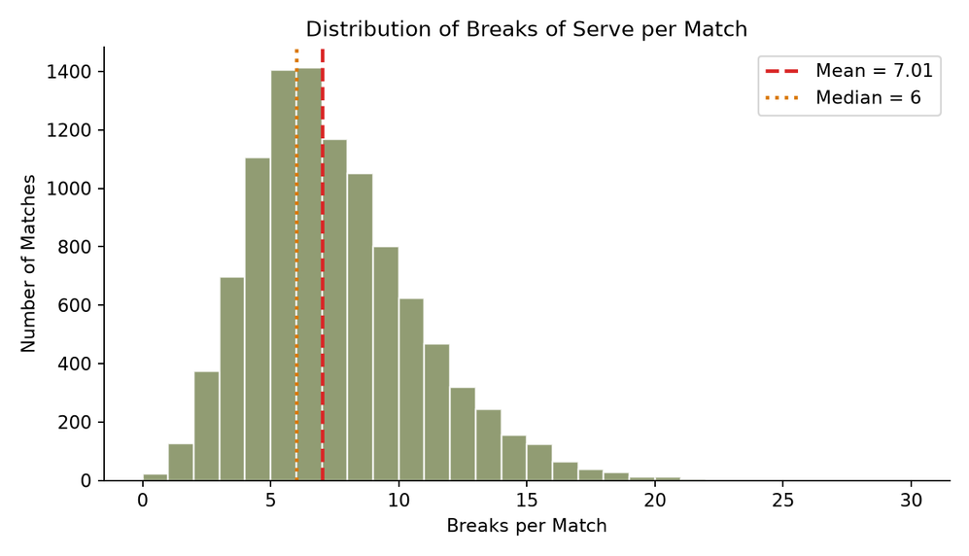
Q17
SECTION 02
What Is the Average Number of Breaks of Serve per Match?
The mean number of breaks per match is 7.01 and the median is 6. The narrow gap between mean and median indicates a relatively symmetrical distribution with a slight right skew. This right-hand tail is caused by 1.6% of data points in the outlier range — retained as genuine occurrences likely from long matches with poor serving quality or tight competition between two strong returners.
7.01
Mean breaks per match · Median: 6
1.6% outliers retained as genuine. 36 matches with only 1-2 games were validated against score data and confirmed as short matches, not incomplete data — so they were not excluded.
FIG. 13 — DISTRIBUTION OF BREAKS OF SERVE PER MATCH
KEYVAN HAJIZADE MATCH STATISTICS & PERFORMANCE
16 / 30
Notes:
- Mean 7.01 vs median 6 — near-symmetrical with a slight right skew.
- Right tail caused by 1.6% outliers, all retained as genuine.
- Outliers likely come from long matches, poor serving, or two strong returners.
- 36 short matches (1-2 games) validated against score data — confirmed short, not incomplete.
- Distribution is cleaner than the aces distribution shown earlier.

Slide 17
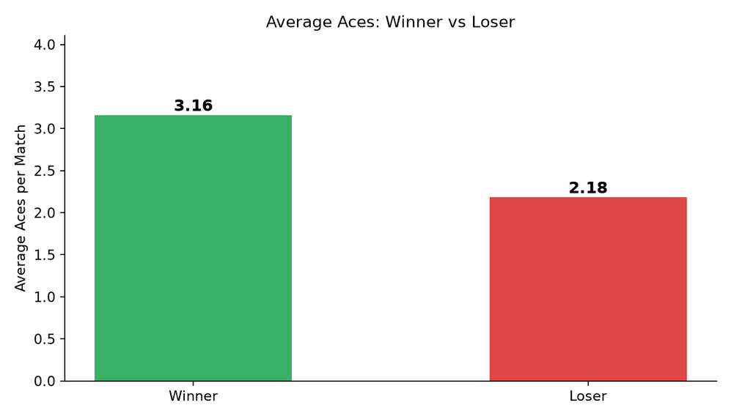

OP1
SECTION 02
Does the Winner Usually Play More Aces?
Winners average 3.16 aces — approximately 45% higher than the 2.18 average for losers. However, this pattern does not hold in every match: winners recorded more aces in only 49.9% of matches, while ace counts were tied in 23%. In the remaining 27%, the loser actually hit more aces but still lost. Aces alone are not a definitive predictor of outcome — it's a general statistical advantage, not an absolute rule.
3.16
2.18
49.9%
Winners · avg aces
Losers · avg aces
Matches where winner had more aces
Matches with missing winner_code were excluded. The 45% average gap coexists with only 49.9% match-level consistency — a classic case where group averages mask individual-match variability.
FIG. 14 — ACES PER MATCH: WINNER VS LOSER
KEYVAN HAJIZADE MATCH STATISTICS & PERFORMANCE
17 / 30
Notes:
- Winners average 3.16 aces vs losers 2.18 — a 45% gap on averages.
- But winners had more aces in only 49.9% of matches — basically a coin-flip.
- Ace counts tied in 23% of matches; loser had more aces in 27%.
- Aces are a statistical tendency, not a deterministic predictor of winning.
- Group averages can mask individual-match variability — a recurring analytical caveat.

Slide 18
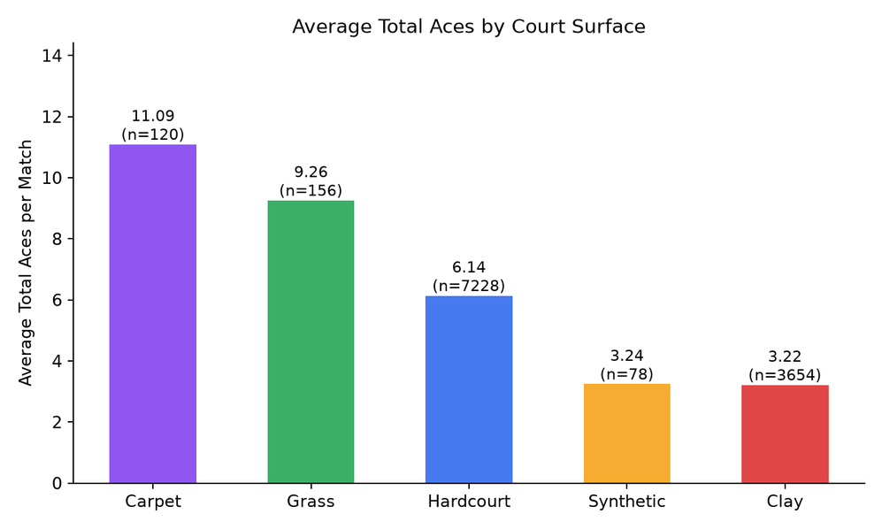
OP2
SECTION 02
Does the Court Surface Affect the Number of Aces?
and clay yield the lowest. Fast courts produce significantly more aces than slow courts — a difference of nearly 3.5× between the highest and lowest rates. This aligns perfectly with tennis physics: on clay, the ball moves more slowly and bounces higher, making service returns easier; on grass and carpet, the ball maintains speed, increasing the likelihood of aces. Grass and carpet yield the highest ace rates; synthetic
Grass · high
Carpet · high
Hardcourt · mid
Synthetic · low
Clay · lowest
3.5×
Gap between fastest & slowest surfaces
Fragmented surface categories (green clay, indoor red clay) were consolidated into five main groups: Hardcourt, Clay, Grass, Carpet, and Synthetic — ensuring statistical significance through adequate sample sizes.
FIG. 15 — AVERAGE ACES PER MATCH BY COURT SURFACE
KEYVAN HAJIZADE MATCH STATISTICS & PERFORMANCE
18 / 30
Notes:
- 3.5× gap in aces between fastest and slowest court surfaces.
- Grass and carpet yield the highest ace rates — fast surfaces keep ball speed.
- Clay and synthetic yield the lowest — slow ball, higher bounce, easier returns.
- Pattern aligns with tennis physics: friction decelerates ball on slow courts.
- Surface sub-categories consolidated into 5 main groups for sample-size significance.

Slide 19
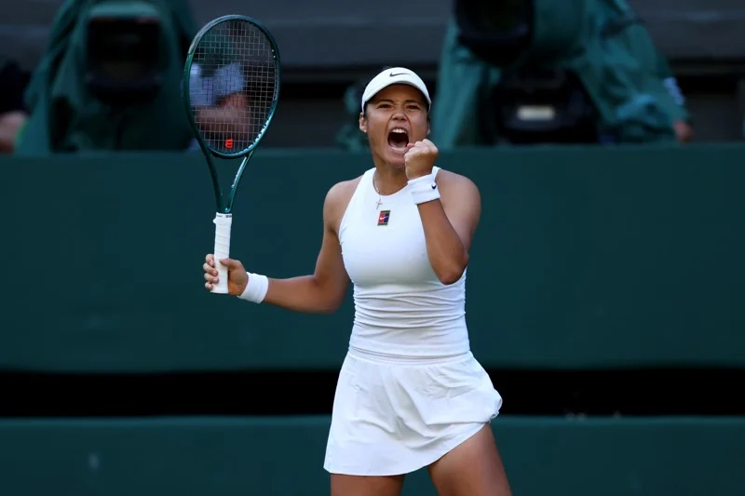

TENNIS MATCHES ANALYSIS REPORT
03 / 03
SECTION THREE / THREE
Match Dynamics &
Data Quality
03
PRESENTED BY Yasamn Aghaei
QUESTIONS IN THIS SECTION
Q3 Highest number of wins
Q4 Longest match by duration
Q5 Typical number of sets
Q6 Most successful countries
Q9 Most tournaments won by a player in a single month
Q11 Average match duration
Q14 Most common surface
OP1
Duration by surface
OP2
Same players: Hard vs Clay
★ Scoring-rule validator
YASAMAN AGHAEI · MATCH DYNAMICS & DATA QUALITY
19 / 30
Notes:
- Section divider opening Yasamn's analysis of match-level dynamics and data quality.
- Covers 10 items: wins, longest match, sets, countries, monthly titles, durations, surfaces.
- Includes two P2 probe questions on duration-by-surface and head-to-head surface comparison.
- Highlights the ★ scoring-rule validator that underpins all upstream analyses.
- Transition cue: "Match dynamics first, then the data-quality layer that supports every claim."

Slide 20

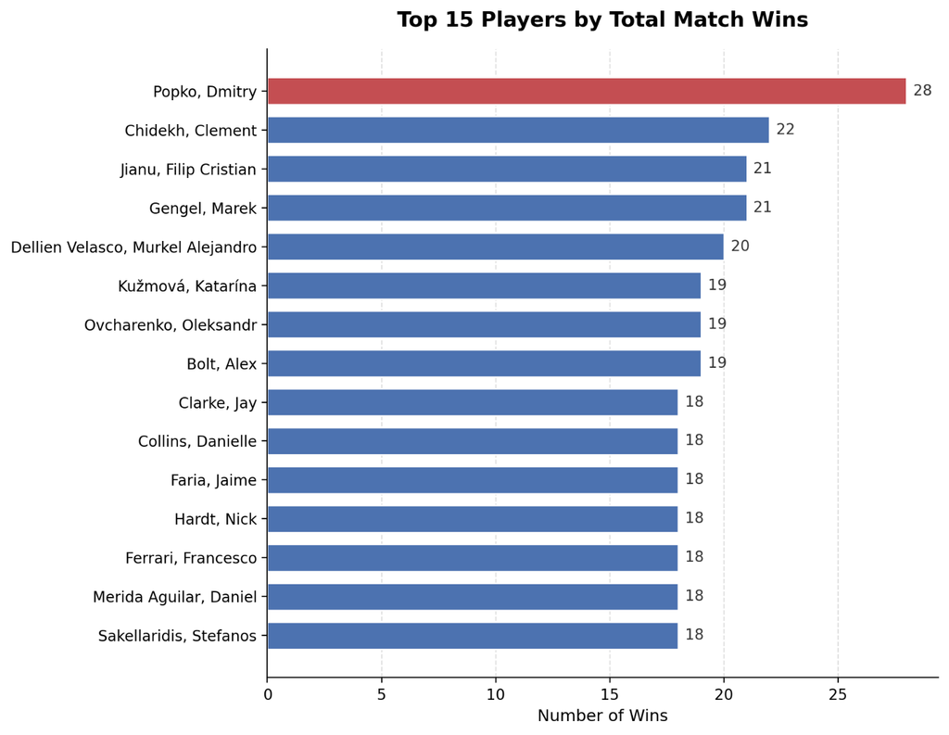
Match Dynamics
Q3 · SECTION 03
Which Player Has the Highest Number of Wins?
Fig. 16 ─ TOP 15 PLAYERS BY TOTAL MATCH WINS
Popko leads with 28 wins, followed by Chidekh (22) and Jianu / Gengel (21 each). The ranking rests on 11,674 wins linked to a player row — about 81% of completed matches with a recorded winner. This is a volume ranking, not a quality ranking: total wins mix how often a player competed and how often they won, so ITF-heavy schedules can produce higher totals than fewer, harder matches at higher tiers.
28
POPKO — HIGHEST TOTAL WINS
2,739 wins were dropped because the winning side had no player row in home_team/away_team. Completed matches with non-null winner_code and score_ready; wins attributed via winner_code (1=home, 2=away).
YASAMAN AGHAEI
20 / 30
Notes:
- Popko leads the field with 28 wins, ahead of Chidekh (22) and Jianu/Gengel (21).
- Ranking covers 11,674 wins linked to a player row — about 81% of completed matches with a recorded winner.
- This is a volume ranking, not a quality ranking — ITF-heavy schedules inflate totals.
- 2,739 wins were dropped because the winning side had no player row in home_team/away_team.
- Wins attributed via winner_code (1=home, 2=away), restricted to completed matches with score_ready.

Slide 21
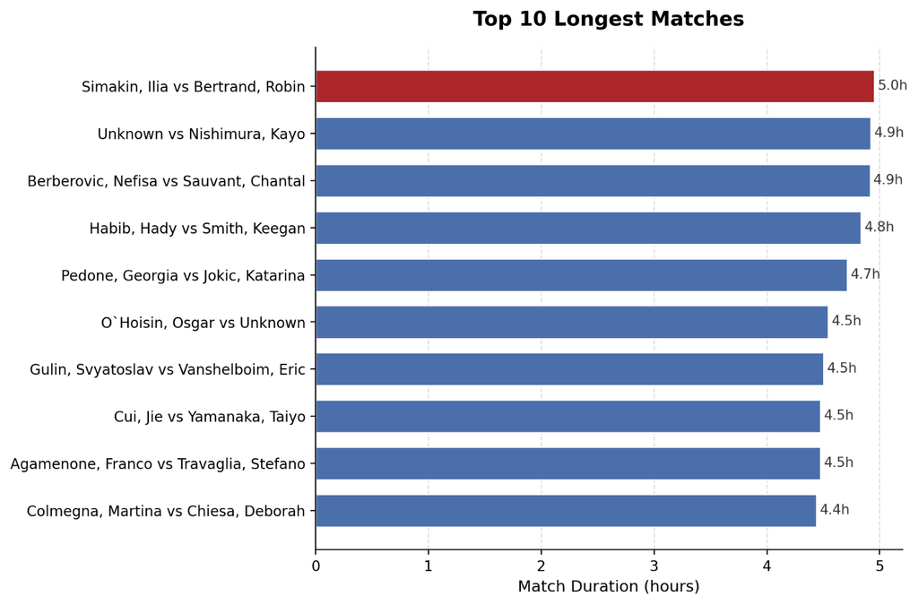
Match Dynamics
Q4 · SECTION 03
Fig. 17 ─ TOP 10 LONGEST MATCHS
What Is the Longest Match by Duration?
The longest match is Simakin vs Bertrand (Monastir, ITF Men, hard outdoor), lasting 4 hours 57 minutes over 35 games on 2024-02-10. The top 10 matches sit between roughly 4.4h and 5.0h. The 300-minute upper cap means this is "longest inside the plausible range," not a claim that no real match exceeded five hours — documented long matches (Federer vs del Potro, 4h 26m at London 2012 Olympics) stay below this threshold.
4h 57m
SIMAKIN VS BERTRAND — 35 GAMES
Duration pipeline: duration_reliable + 15–300 minute window + completed matches + games cross-check. Lower bound (15 min) removes 3 retirement-like rows; upper bound (300 min) removes 14 suspect extreme values. Same pipeline used for Q11 and surface-duration analyses.
YASAMAN AGHAEI
21 / 30
Notes:
- Longest match: Simakin vs Bertrand, 4h 57m over 35 games (Monastir, ITF Men, hard outdoor, 2024-02-10).
- Top 10 longest matches sit in the 4.4h–5.0h range.
- 300-minute cap is a plausibility filter, not an absolute upper bound on real matches.
- Federer vs del Potro (London 2012 Olympics, 4h 26m) sits below the threshold — validates the cutoff.
- Same duration pipeline reused for Q11 and surface-duration analyses.

Slide 22
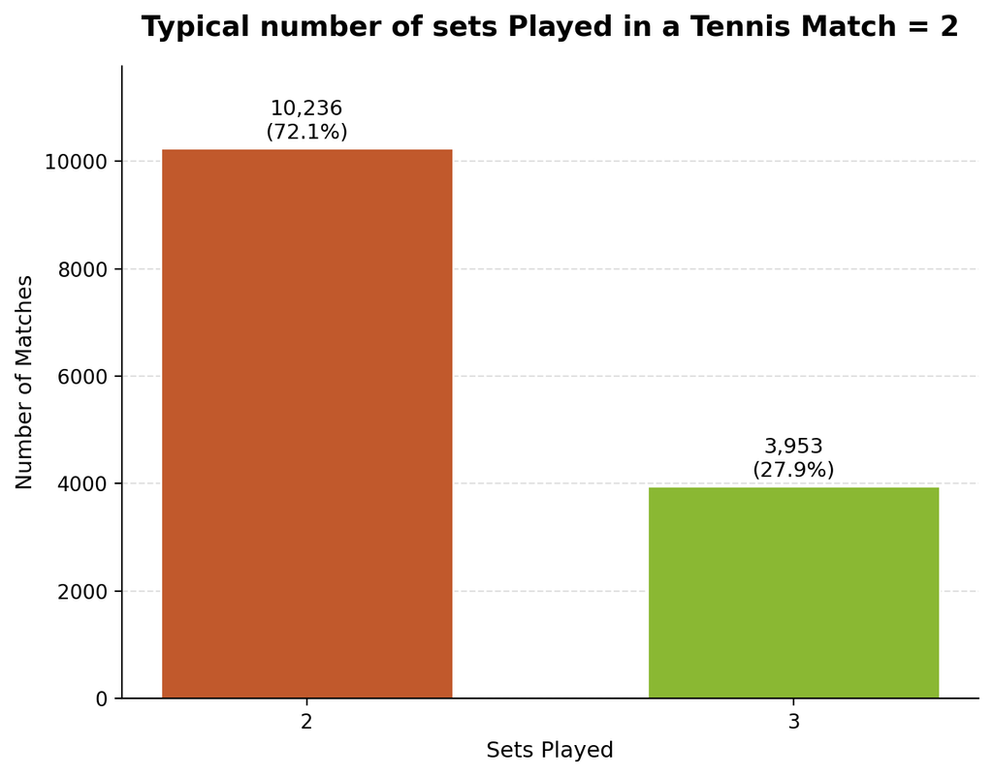
Match Dynamics
Q5 · SECTION 03
Fig. 18 ─ Typical number of sets played
What Is the Typical Number of Sets per Match?
Of 14,189 completed matches, 72.1% end in 2 sets and 27.9% in 3 sets (mean 2.28). This matches the best-of-3 structure perfectly: straight-set wins stop at two sets, so a ~72/28 split means most matches do not reach a decider. Agreement with the independent power table is 100% on 10,074 overlapping matches, confirming the result is robust.
72.1%
MATCHES ENDING IN 2 SETS
sets_played aligned from home and away score tables (max of the two); restricted to match_completed; cross-checked against max set_num from power table. 100% agreement on 10,074 overlapping matches validates the alignment logic.
YASAMAN AGHAEI
22 / 30
Notes:
- 72.1% of completed matches end in 2 sets; 27.9% in 3 sets; mean = 2.28 sets.
- Distribution mirrors best-of-3 structure exactly — most matches never reach a decider.
- Cross-checked against the independent power table: 100% agreement on 10,074 overlapping matches.
- sets_played derived as max(home, away) from score tables, restricted to match_completed.
- Result is robust — no alignment drift detected between the two sources.

Slide 23
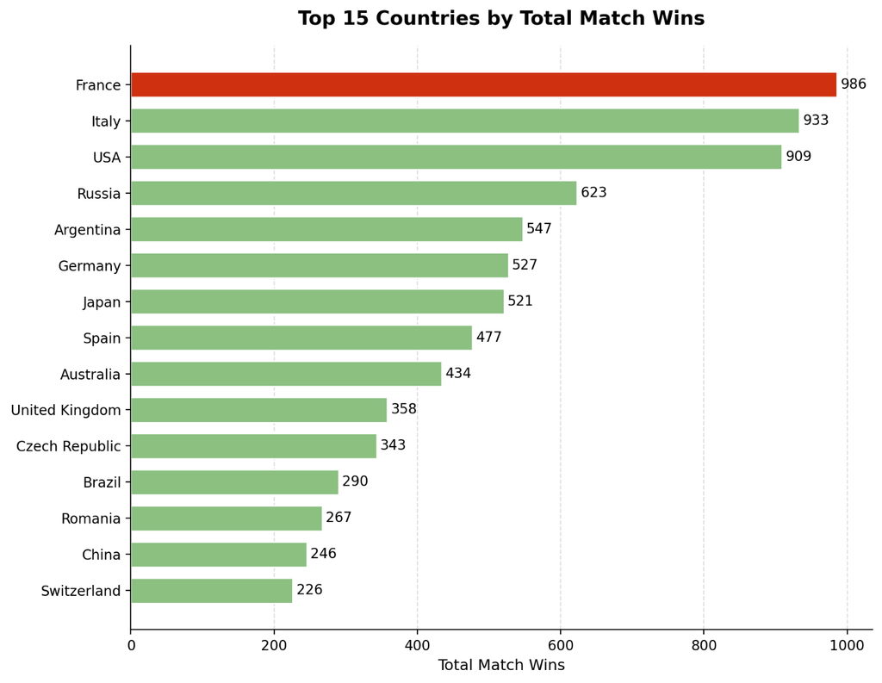
Match Dynamics
Q6 · SECTION 03
Fig. 19 ─ TOP 15 Countries by Total Match Wins
Which Country Produces the Most Successful Players?
By total wins: France (986), Italy (933), USA (909). But by wins per player (with ≥50 players): Argentina (5.58), Brazil (5.00), France (4.88), Spain (4.87), Czech Republic (4.83). "Most successful" is not a single fact — total wins reward large player pools, while wins per player rewards efficiency but is sensitive to the cutoff threshold.
France 986
Argentina 5.58
TOTAL WINS LEADER
WINS / PLAYER LEADER
Same win attribution as Q3, grouped by country. Secondary metric = total wins / distinct players with a minimum player-count threshold. A few players with multiple country labels were left as diagnostic noise rather than force-merged.
YASAMAN AGHAEI
23 / 30
Notes:
- France leads total wins (986), ahead of Italy (933) and USA (909).
- Argentina leads wins per player (5.58) at the ≥50-player threshold.
- "Most successful" is definition-dependent: total wins = volume; wins/player = efficiency.
- Wins-per-player ranking is sensitive to the player-count cutoff threshold.
- Same win attribution as Q3, grouped by country; multi-label players kept as diagnostic noise.

Slide 24
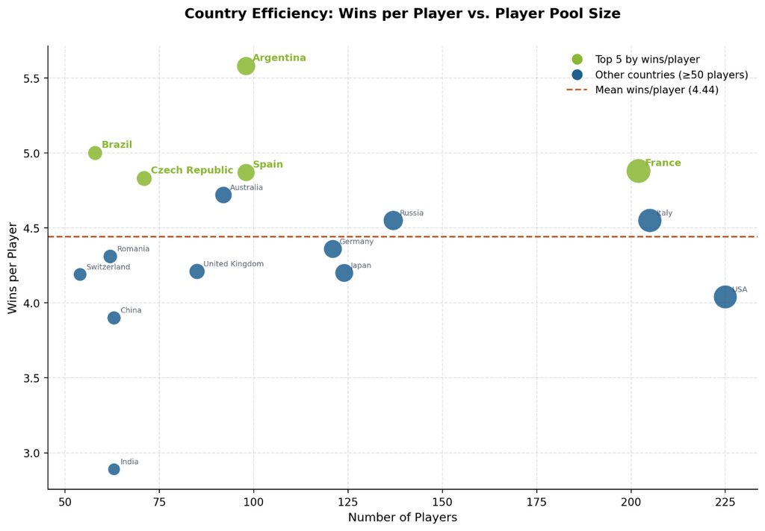
Match Dynamics
Q6 · SECTION 03
Fig. 20 ─ Wins per Players vs. Player Pool Size
Which Country Produces the Most Successful Players?
THE BETTER QUESTION IS:
Which Countries Are Most Efficient by Wins Per Player?
Among countries with ≥50 players, Argentina leads efficiency at 5.58 wins/player, followed by Brazil (5.00), France (4.88), Spain (4.87), and Czech Republic (4.83). The 50-player threshold filters out small samples. Efficiency differs from raw win totals — high-volume countries do not always dominate per-player output.
Brazil
5.oo
Argentina 5.58
WINS / PLAYER LEADER
WINS / PLAYER LEADER
YASAMAN AGHAEI
24 / 30
Notes:
- France leads total wins (986), ahead of Italy (933) and USA (909).
- Argentina leads wins per player (5.58) at the ≥50-player threshold.
- "Most successful" is definition-dependent: total wins = volume; wins/player = efficiency.
- Wins-per-player ranking is sensitive to the player-count cutoff threshold.
- Same win attribution as Q3, grouped by country; multi-label players kept as diagnostic noise.

Slide 25
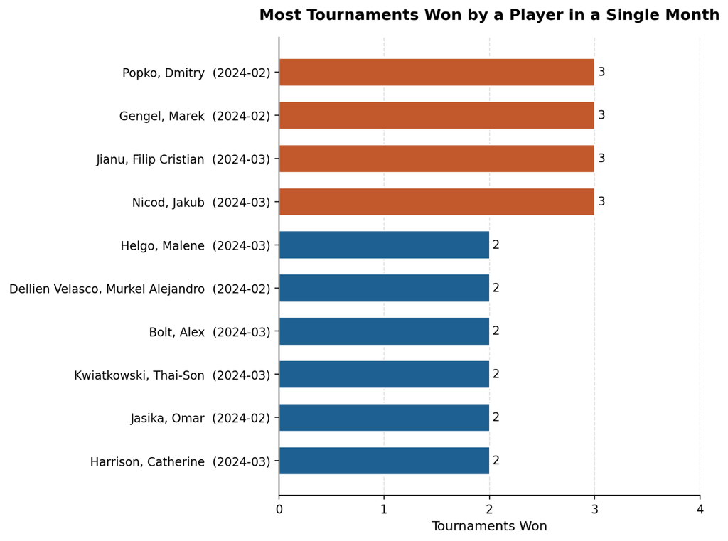
Match Dynamics
Q9 · SECTION 03
Fig. 21 ─ Most Tournaments Won by a Player in a single Month
What Is the Most Tournaments Won in a Single Month?
The maximum is 3 tournaments in one month, reached by four players — Popko, Gengel, Jianu, and Nicod — in Feb–Mar 2024, all in ITF Men. Three events in one month fits the weekly ITF calendar structure. The same pattern is less likely at ATP level because events are spaced further apart and fields are deeper. Of 260 main-draw finals, 28 had no recorded winner and were excluded.
3 tournaments
IN ONE MONTH — 4 PLAYERS (FEB–MAR 2024)
Restricted to main draw (qualifying excluded); is_final matches only; required completed match with winner; player attributed as in Q3; grouped by player × month. Measured only over months present in the data.
YASAMAN AGHAEI
25 / 30
Notes:
- Maximum is 3 titles in a single month, reached by four players.
- Popko, Gengel, Jianu, and Nicod all hit 3 titles in Feb–Mar 2024 (ITF Men).
- Pattern fits the weekly ITF calendar structure; ATP events are spaced further apart.
- ATP-level repeats are less likely — wider spacing and deeper fields.
- 28 of 260 main-draw finals had no recorded winner and were excluded from the count.

Slide 26
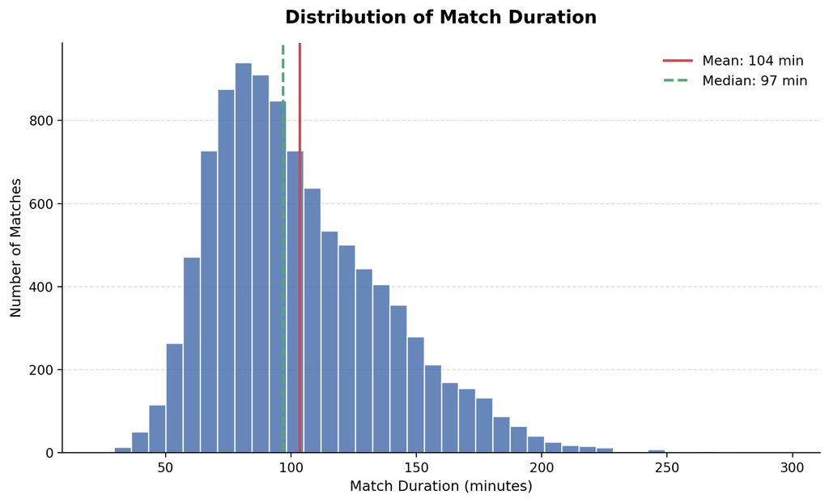
Match Dynamics
Q11 · SECTION 03
Fig. 22 ─ Distribution of Match Duration
What Is the Average Match Duration?
Using the same duration pipeline as Q4: mean 103.6 minutes, median 96.8, standard deviation 35.2 (n=10,075). The mean sitting above the median indicates right-skew. By sets: ~87.8 minutes for 2-set matches vs ~139.6 minutes for 3-set matches — the ~52-minute gap is consistent with the cost of one extra full set.
103.6 min
96.8 min
87.8 → 139.6
MEAN (N=10,075)
MEDIAN
2 SETS → 3 SETS (+52 MIN)
duration_reliable + 15–300 minutes + completed matches + games cross-check. Same pipeline as Q4. Describes the filtered population only — retirements and corrupted/incomplete durations are out of scope by design.
YASAMAN AGHAEI
26 / 30
Notes:
- Mean match duration is 103.6 min (n=10,075); median 96.8 min — right-skewed distribution.
- Standard deviation 35.2 min; same duration pipeline as Q4.
- 2-set matches average ~87.8 min; 3-set matches ~139.6 min — gap of ~52 min per extra set.
- Right skew comes from the long tail of extended 3-set matches.
- Filtered population only — retirements and corrupted durations excluded by design.

Slide 27
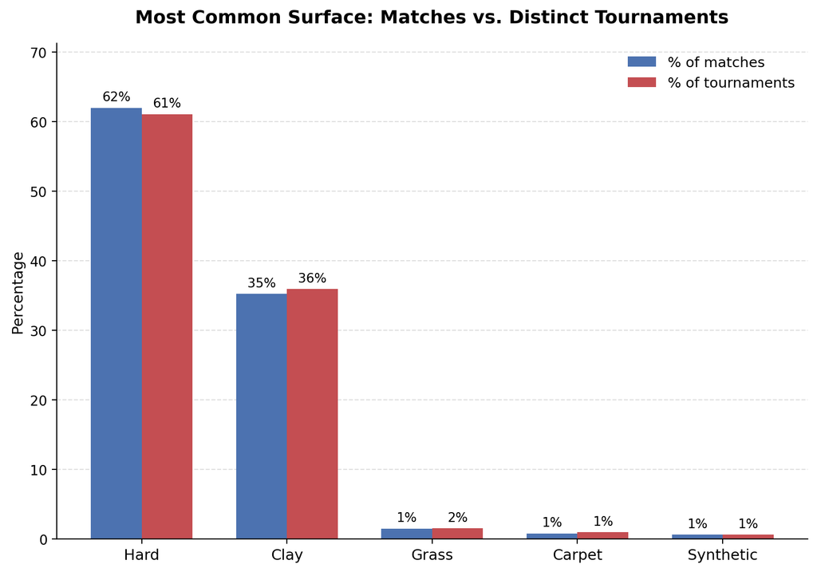
Match Dynamics
Q14 · SECTION 03
Fig. 23 ─ Most Common surface
What Is the Most Common Surface?
Hard court is first at both levels — ~62% of matches and ~61% of tournaments — with Clay second at ~35–36%. Match-level and tournament-level shares are close, so draw-size differences by surface are small in this dataset. 8 of 529 tournament groups had mixed surface labels (mode used for resolution); the inconsistency is real data noise, not silently fixed.
~62%
HARD COURT — MOST COMMON SURFACE
Match-level counts from ground_type; tournament-level via mode of surface within (tournament_name, category). Broad families: Hard / Clay / Grass / Carpet / Synthetic. 8 mixed-label groups resolved via mode — ranking unchanged.
YASAMAN AGHAEI
27 / 30
Notes:
- Hard court dominates: ~62% of matches and ~61% of tournaments.
- Clay is the second surface at ~35–36% of matches/tournaments.
- Match-level and tournament-level shares are very close — small draw-size differences by surface.
- Grass, Carpet, and Synthetic are minor surface families in this dataset.
- 8 of 529 tournament groups had mixed surface labels — real data noise, mode-resolved (ranking unchanged).

Slide 28
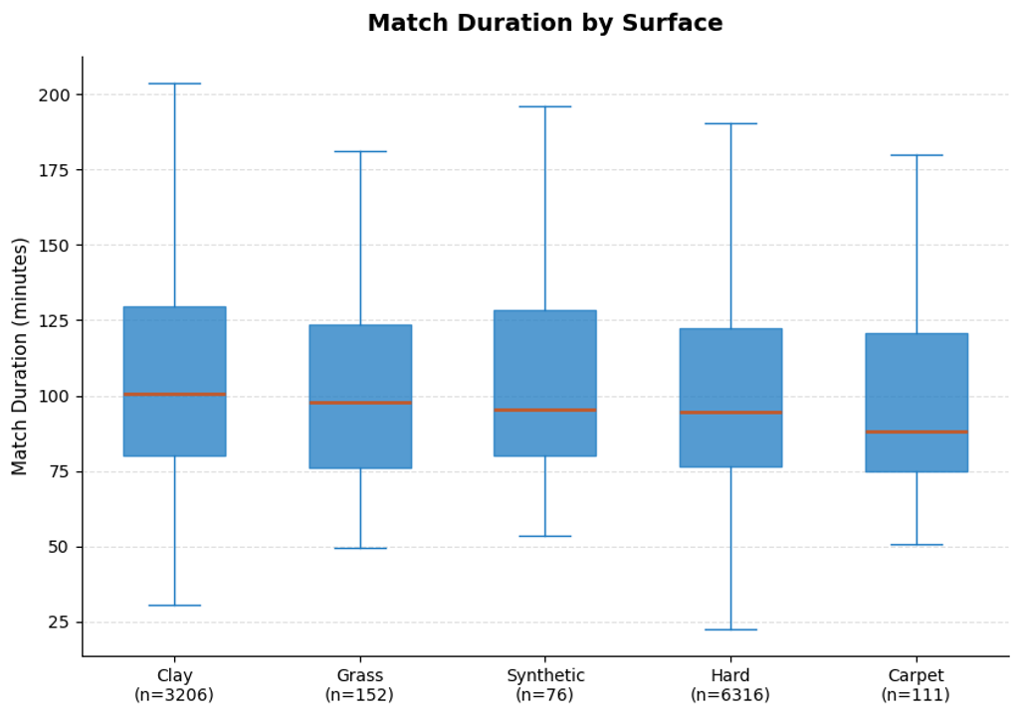
Match Dynamics
OP1 · SECTION 03
Fig. 24 ─ Match Duration by Surface
How Does Match Duration Vary by Surface?
Median match minutes by surface: Clay 100.8 (n=3,206), Grass 98.0 (n=152), Synthetic 95.4 (n=76), Hard 94.6 (n=6,316), Carpet 88.2 (n=111). The only large-sample contrast is Clay vs Hard — about 6 minutes at the median. Grass, Synthetic, and Carpet medians rest on much smaller samples and are less stable.
100.8 min
CLAY MEDIAN (N=3,206) — LONGEST
Same duration pipeline: duration_reliable + 15–300 min. Outliers hidden on the boxplot for readability. Only Clay (n=3,206) and Hard (n=6,316) have sample sizes large enough for stable conclusions.
YASAMAN AGHAEI
28 / 30
Notes:
- Clay produces the longest matches: median 100.8 min (n=3,206).
- Hard court is the shortest large-sample surface: median 94.6 min (n=6,316).
- Clay-vs-Hard gap at the median is only about 6 minutes.
- Grass (n=152), Synthetic (n=76), and Carpet (n=111) samples are too small to be stable.
- Only Clay and Hard comparisons are statistically robust; outliers hidden on the boxplot.

Slide 29
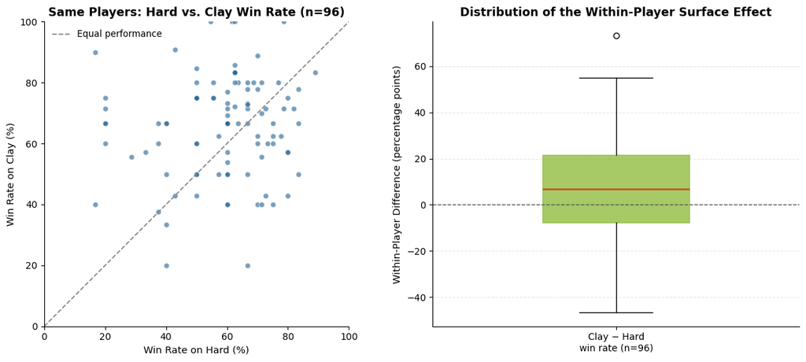
Match Dynamics
OP2 · SECTION 03
Fig. 25 ─ Players Win Rate On Hard vs. Clay
Do the Same Players Perform Differently on Hard vs Clay?
Among 96 players with ≥5 matches on both surfaces, the mean within-player difference (Clay − Hard) is +6.8 percentage points: 55 players were better on Clay, 36 on Hard, 5 tied. Paired t-test: t=2.94, p=0.004. Each player is their own control — the test asks whether the average of (Clay rate − Hard rate) differs from zero. p is not effect size; +6.8 pp is modest.
+6.8 pp
CLAY − HARD (T=2.94, P=0.004)
≥5-match threshold on both surfaces. Dependence across a player's matches is not modelled — the t-test is a first-pass average test, not a full causal model. Individual differences spread widely, so the mean does not describe most players.
YASAMAN AGHAEI
29 / 30
Notes:
- 96 players with ≥5 matches on both Hard and Clay; mean within-player Clay − Hard = +6.8 pp.
- 55 players better on Clay, 36 better on Hard, 5 tied — Clay-leaning asymmetry.
- Paired t-test: t=2.94, p=0.004 — statistically significant.
- Effect size is modest; p is not effect size, and individual differences spread widely.
- Result is threshold-dependent and not a full causal model (within-player match dependence not modelled).

Slide 30
DATA QUALITY · SCORING VALIDATOR
· SECTION 03
Tennis Scoring-Rule Validator — Data Quality Layer
A scoring-rule validator aligns sets_played between home and away score tables, classifies every set under correct tennis rules (6-x / 7-5 / 7-6, match/super TB, advantage sets), and flags genuine anomalies — illegal 7-x scores, tiebreak mismatches, winner-vs-games contradictions, best-of-3 overruns, and implausible durations. This validator is the upstream filter that makes every Q3–Q14 denominator defensible.
~1,490
~1,721
MATCHES WITH BAD SET STATUS
ANOM_7 SET-LEVEL CASES
14,413
275
SCORE_READY (USABLE)
RETIREMENT-LIKE MATCHES
YASAMAN AGHAEI
30 / 30
Notes:
- Validator aligns home/away score tables and classifies every set under correct tennis rules.
- Flags ~1,490 matches with bad set status; ~1,721 anom_7 set-level cases (illegal 7-x scores).
- Produces score_ready (14,413 usable matches) and is_retirement_like (275) flag columns.
- 0 best-of-3 overruns survive valid-set filtering.
- Underpins every Q3–Q14 denominator: score_ready, duration_reliable, and retirement-like exclusion feed all downstream analyses.

